Slide 1
Geometria Computacional
Convex Hull

Slide 2
Integrantes
→ Pedro A C Santos
→ João Pimenta
→ Ítalo Rosa
→ Bruna Lima
→ Leonardo Oliveira

Slide 3
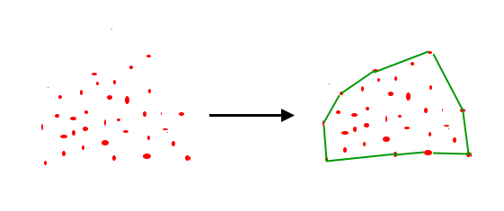
Convex Hull
Fonte: https://www.geeksforgeeks.org/

Slide 4
Convex Hull: Algoritmos
Gift wrapping aka Jarvis march — O(nh)
Graham scan — O(n log n)
Quickhull
Divide and conquer — O(n log n)
Monotone chain aka Andrew's algorithm— O(n log n)
Incremental convex hull algorithm — O(n log n)

Slide 5
Convex Hull: Algoritmos
The ultimate planar convex hull algorithm — O(n log h)
Chan's algorithm — O(n log h)

Slide 6
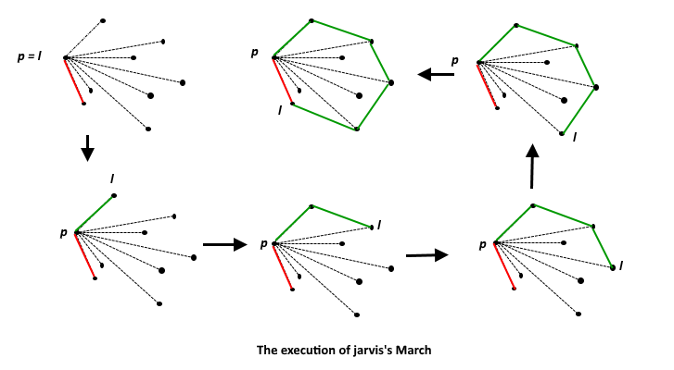
Convex Hull: Jarvis March
Fonte: https://www.geeksforgeeks.org/

Slide 7
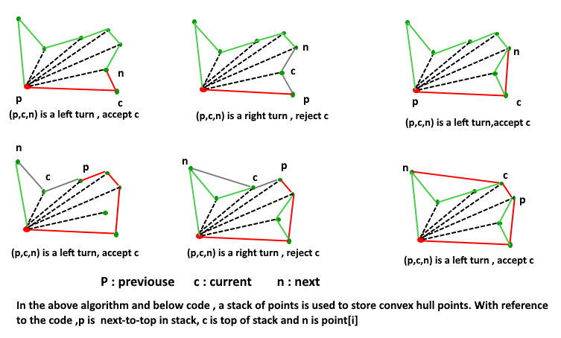
Convex Hull: Graham Scan
Fonte: https://www.geeksforgeeks.org/

Slide 8
Convex Hull: Graham Scan
Exemplo:

Slide 9
Convex Hull: Graham Scan
Exemplo:
6
5
4
3
2
1
0

Slide 10
Convex Hull: Graham Scan
Exemplo:
6
5
4
3
2
1
0
Hull: 2,1,0 → 1,0
Ângulo de: 2,1,3
X

Slide 11
Convex Hull: Graham Scan
Exemplo:
6
5
4
3
2
1
0
Hull: 1,0 → 0
Ângulo de: 1,0,3
Hull: 3,1,0
V

Slide 12
Convex Hull: Graham Scan
Exemplo:
6
5
4
3
2
1
0
Hull: 3,1,0 → 1,0
Ângulo de: 1,3,4
Hull: 4,3,1,0
V

Slide 13
Convex Hull: Graham Scan
Exemplo:
6
5
4
3
2
1
0
Hull: 4,3,1,0 → 3,1,0
Ângulo de: 3,4,5
Hull: 3,1,0
X

Slide 14
Convex Hull: Graham Scan
Exemplo:
6
5
4
3
2
1
0
Hull: 4,3,1,0 → 3,1,0
Ângulo de: 3,4,5
Hull: 6,4,3,1,0
V

Slide 15
Convex Hull: Graham Scan
Exemplo:
Obs.: O pt 5 está abaixo da reta que liga o pt 4 ao 6.
Caso estivesse na reta, pertenceria ao hull também.

Slide 16
Graham: Código
#include <iostream>
#include <vector>
#include <stack>
#include <algorithm>
using namespace std;
#define pb push_back
class Point{
public:
int x, y;
bool operator < (Point _aux) {
return (this->y==_aux.y)? this->x<_aux.x : this->y < _aux.y;
}
};
Point pivot;
vector<Point> points;
int posLeftMost(); //Position to Bottommost/leftmost point
int crossProduct(Point a, Point b, Point c); //Direction
int sqrDist(Point a, Point b); //pow(Distance between 2 points,2)
bool POLAR_ORDER(Point a, Point b); //Order function used in sort (i.angle, ii.ray)
stack<Point> grahamScan(vector<Point> &points); //graham's Scan

Slide 17
Graham: Código
int main() {
Points = {{0, 3}, {1, 1}, {2, 2}, {4, 4},{0, 0}, {1, 2}, {3, 1}, {3, 3}};
Point aux;
stack<Point> hull = grahamScan(points);
while (!hull.empty()){
Point p = hull.top();
hull.pop();
printf("(%d, %d)\n", p.x, p.y);
}
return 0;}

Slide 18
Graham: Código
int posLeftMost(){
int leastY=0;
for(int i=1; i<points.size(); i++)
if (points[i] < points[leastY]) leastY = i;
return leastY;
}
int crossProduct(Point a, Point b, Point c){
int prodVetorial = (b.x-a.x)*(c.y-a.y) - (b.y-a.y)*(c.x-a.x);
return (prodVetorial==0)? 0 :(prodVetorial>0)? -1 : 1; //Collinear, left(counterclock), right(clockwise)
}

Slide 19
Graham: Código
stack<Point> grahamScan(vector<Point> &points){
stack<Point> hull;
if (points.size() < 3) return hull; //Needs 3 points at least
int leastY=posLeftMost();
swap(points[leastY], points[0]);
pivot = points[0]; //Take the pivot element
sort(points.begin()+1, points.end(), POLAR_ORDER); //Put in polar order
int sqrDist(Point a, Point b){
return (a.x-b.x)*(a.x-b.x) + (a.y-b.y)*(a.y-b.y);
}
bool POLAR_ORDER(Point a, Point b){
return(crossProduct(pivot,a,b)==0)
? (sqrDist(pivot, a) < sqrDist(pivot, b))
: ((crossProduct(pivot, a, b) == -1));
}

Slide 20
Graham: Código
hull.push(top);
hull.push(points[i]);
}
return hull;
}
hull.push(points[0]);
hull.push(points[1]);
hull.push(points[2]);
for(int i=3; i < points.size(); i++){
Point top = hull.top();
hull.pop();
while(crossProduct(hull.top(), top, points[i]) != -1){
top = hull.top();
hull.pop();
}

Slide 21
URI-1464
Objetivo: Contar quantas vezes é possível aplicar o convex Hull.
→ Estoura usando Jarvis
→ Usando Graham Scan:
Problemas:
  Números repetidos

Slide 22
Referências
Gift Wrapping Algorithm: https://www.youtube.com/watch?v=ZnTiWcIznEQ
Geeks for Geeks³: https://www.geeksforgeeks.org/convex-hull-set-1-jarviss-algorithm-or-wrapping/
Wikipedia⁴: https://en.wikipedia.org/wiki/Convex_hull_algorithms

